Slide 1
Module 1
Introduction

Slide 2
Welcome to 190F: Foundations of Data Science
Instructor placeholder

Slide 3
Data Science

Slide 4
What is Data Science?
Drawing useful conclusions from data using computation
Exploration
Identifying patterns in information
Uses visualizations
Inference
Quantifying whether those patterns are reliable
Uses randomization
Prediction
Making informed guesses
Uses machine learning

Slide 5
Applications
Data science is driven by applications
Data analysis is playing an increasingly important role in may fields including Biology, Chemistry, Economics, Earth Systems, Education, Environmental Science, Finance, Geography, Geology, Kinesiology, Linguistics, Management, Political Science, Public Health, Psychology, Sociology, …
Every data-driven subject brings new challenges

Slide 6
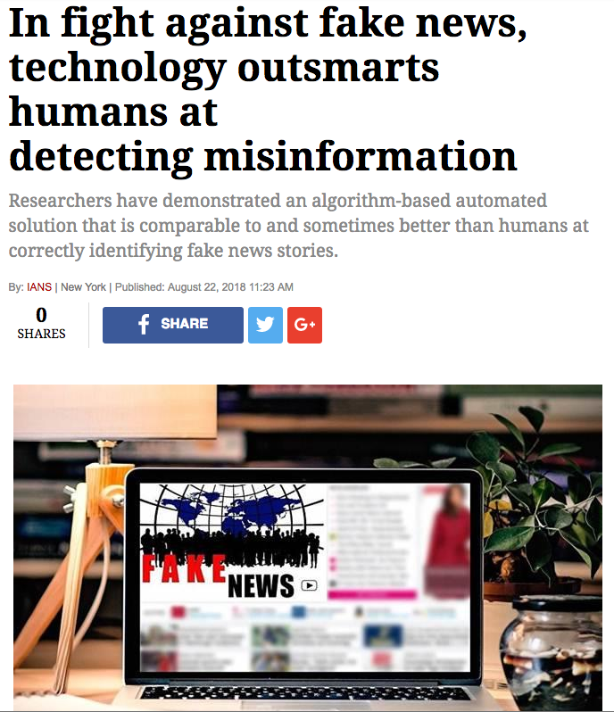

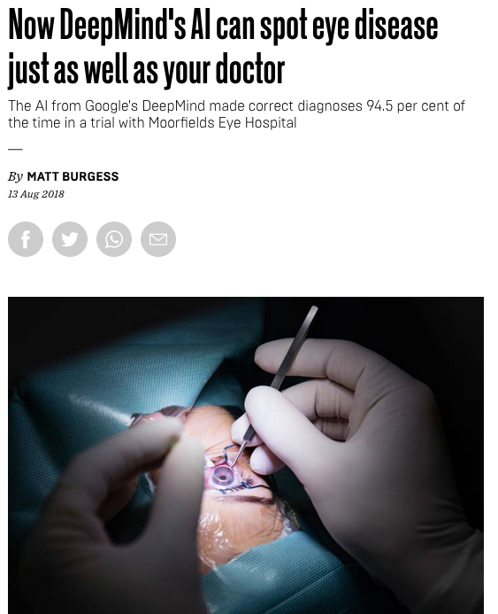
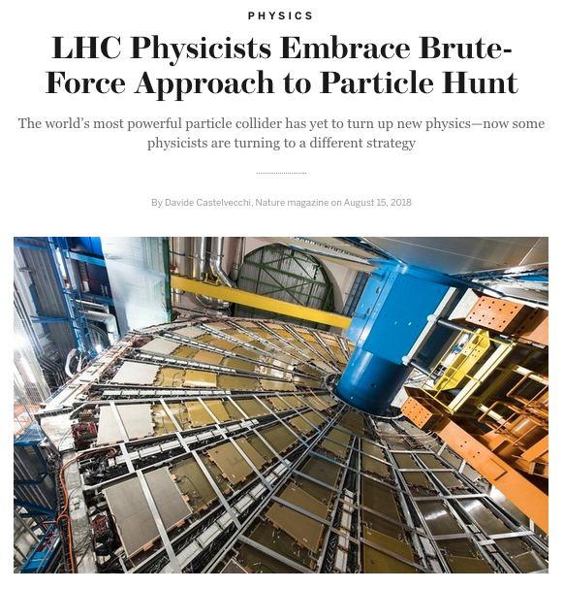
Examples

Slide 7
Course Structure

Slide 8
What does the course cover?
An introduction to programming in Python with a focus on manipulating, visualizing, and analyzing data.
An introduction to statistics that is grounded in computer simulations.
An introduction to predictive modeling and machine learning.

Slide 9
Course Components and Grading
Lectures (often interactive)
Weekly labs including attendance (pass/fail)
Weekly graded homework assignments
Midterm exam & final exam
Homework | 35%
Labs | 20%
Midterm Exam | 20%
Final Exam | 25%

Slide 10
Course Technology
Moodle: Online gradebook
Piazza: Online discussion forums, course Q&A, announcements, and instructor DM.
Github.io: Course website (lecture slides, demos, assignments, labs, etc.)
DataHub: Web-based Python compute environment for completing labs and homework assignments.
Links to all resource can be found on Moodle.

Slide 11
Course Policies
Late Homework
Re-grades
Academic Honesty
https://umass-data-science.github.io/190fwebsite/policies/

Slide 12
Collaboration Policy
Asking questions is highly encouraged
You can discuss homework and lab questions with each other
Do not take notes or pictures out of discussions
The work you turn in must be your own
The Limits of collaboration
Don't share solution material of any type with each other
Copying solutions from any source will be dealt with under UMass’ Academic Honesty procedures: https://www.umass.edu/honesty/

Slide 13
Getting Help
The course staff are here to help you be successful in the course!
When you need help come to office hours or post on the Piazza discussion forums.
The lab sessions are also a good time to ask questions and get help.

Slide 14
Let’s Dive In!

Slide 16
Module 1
Cause and Effect

Slide 17
Announcements

Slide 18
Datahub
If you have an @umass.edu email address, you should now be able to access the course’s data hub.
Datahub uses UMass Google Apps authentication. Use your @umass.edu email address and Spire password to log in. It takes a minute to start up.
When you’re done working with the Datahub, make sure to shut your datahub server down and then log out.

Slide 19
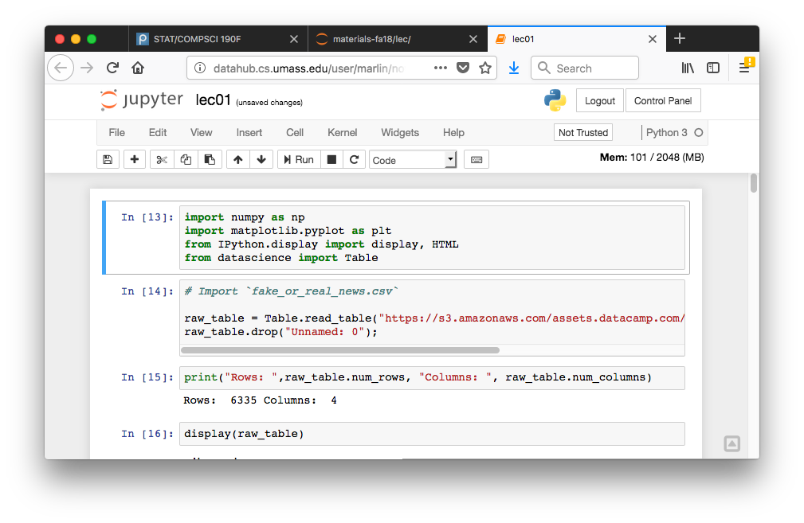
Stopping Your Data Hub

Slide 20
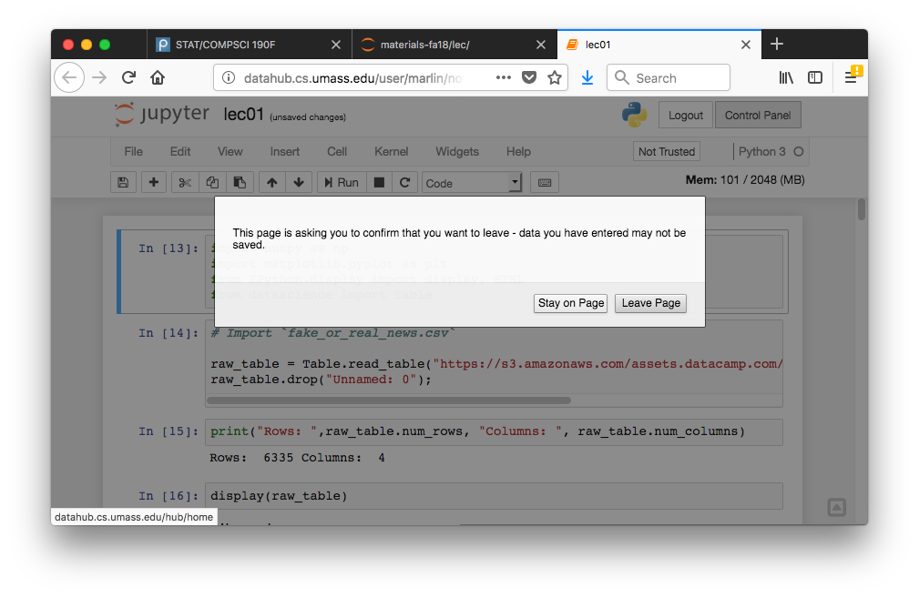
Stopping Your Data Hub

Slide 21
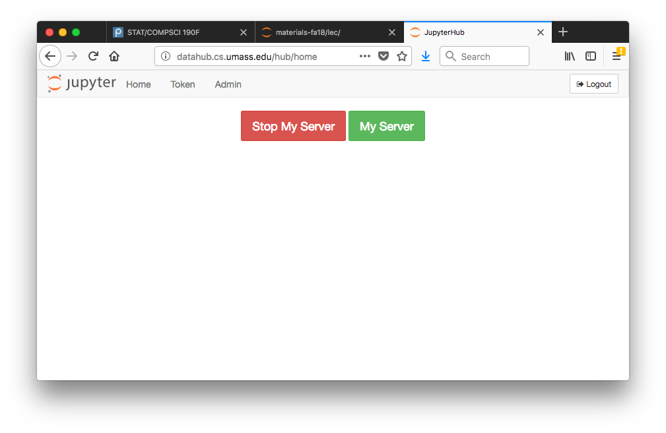
Stopping Your Data Hub

Slide 22
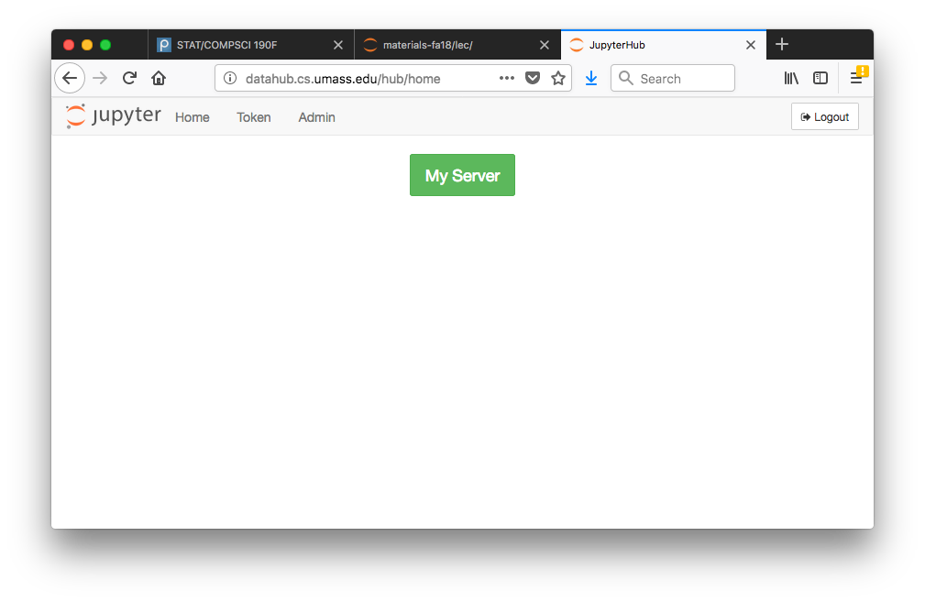
Stopping Your Data Hub

Slide 23
Association vs Causation

Slide 24
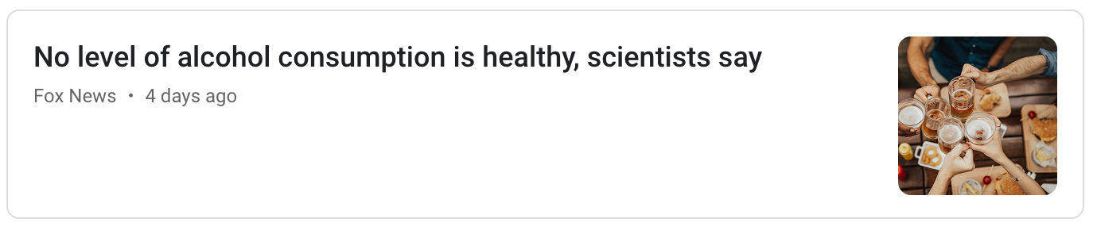
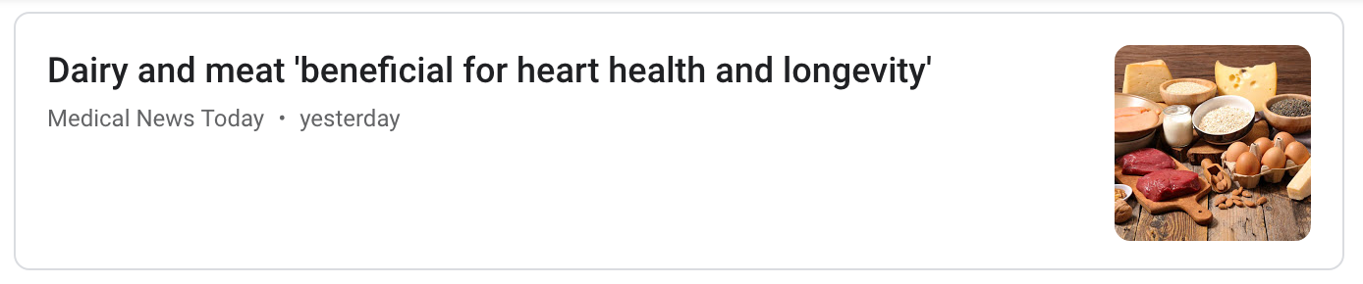
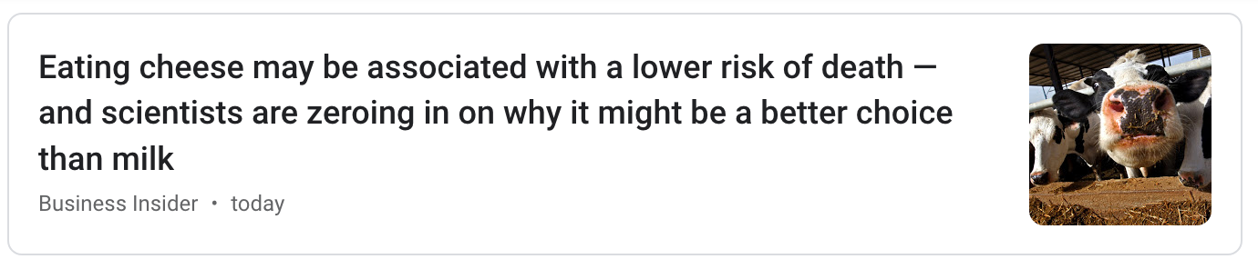
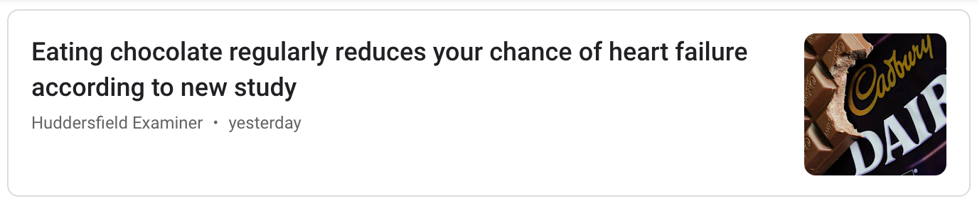
Examples

Slide 25
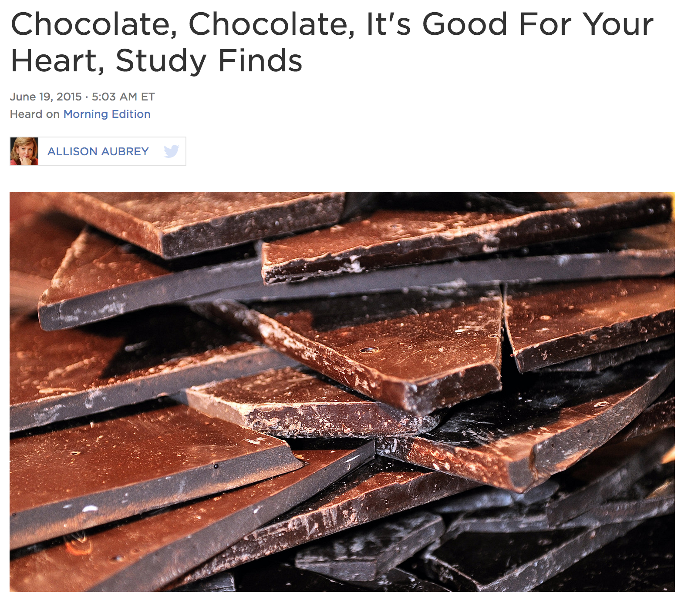
Chocolate and Heart Disease: Study
Population (Individuals, study subjects, partici-pants, units): 20K European adults followed for 12 years.
Treatment: chocolate consumption
Outcome: heart disease
https://www.npr.org/sections/thesalt/2015/06/19/415527652/chocolate-chocolate-its-good-for-your-heart-study-finds

Slide 26
Chocolate and Heart Disease: Association
Question 1: Is there any association (any relationship) between chocolate consumption and heart disease?
Data: “Among those in the top tier of chocolate consumption, 12 percent developed or died of cardiovascular disease during the study, compared to 17.4 percent of those who didn’t eat chocolate.”
Answer: Yes, this points to an association

Slide 27
Chocolate and Heart Disease: Causation
Question 2: Does chocolate consumption lead to a reduction in heart disease?
This questions asks about causality
This question is often harder to answer.
“[The study] doesn’t prove a cause-and-effect relationship between chocolate and reduced risk of heart disease and stroke.” - JoAnn Manson, chief of Preventive Medicine at Brigham and Women’s Hospital, Boston

Slide 28
Chocolate and Heart Disease: Alternatives
Question 3: Is the fact that people ate more chocolate the only possible cause for the observed effect of decreased heart disease risk?
For example, suppose the people who ate more chocolate tended to live in European countries with better health care?
What if wealthier people eat more chocolate and can also afford better health care?

Slide 29
Proving Cause and Effect

Slide 30
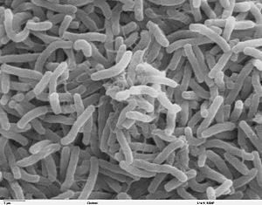
Broad Street Cholera Outbreak
The Broad Street cholera outbreak was a severe outbreak of cholera that occurred in 1854 near Broad Street in the Soho district of London, England.
This outbreak killed 616 people.

Slide 31
Two Theories of Cholera
Miasma theory: cholera was caused by particles in the air, or "miasmata", which arose from decomposing matter or other dirty organic sources.
Germ theory: the principal cause of cholera was a germ cell that had not yet been identified, but was transmitted through food or drink.

Slide 32
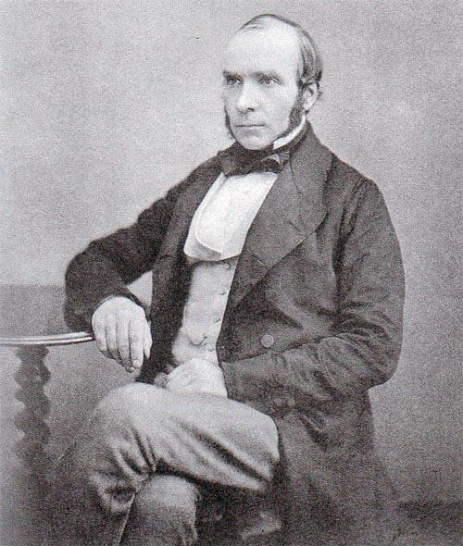
John Snow, 1813-1858

Slide 33
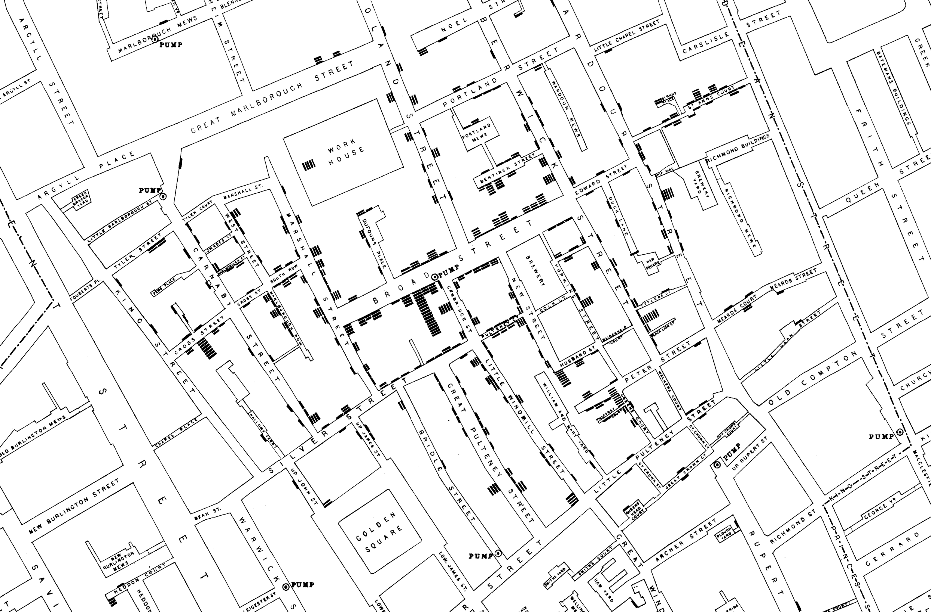

Slide 34


Slide 35
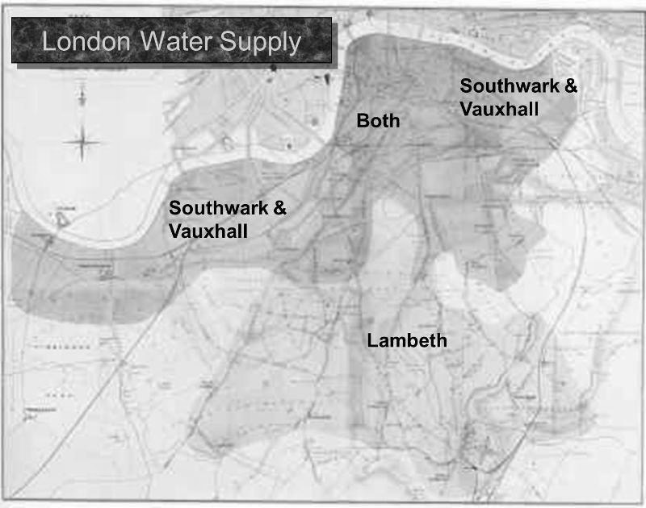

Slide 36
Comparison
Treatment group: Do receive the treatment
Control group: Do not receive the treatment

Slide 37
Snow’s “Grand Experiment”
“… there is no difference whatever in the houses or the people receiving the supply of the two Water Companies, or in any of the physical conditions with which they are surrounded …”
The two groups were similar except for the treatment.

Slide 38
Snow’s table
Supply Area | Number of houses | Cholera deaths | Deaths per 10,000 houses
S&V | 40,046 | 1,263 | 315
Lambeth | 26,107 | 98 | 37
Rest of London | 256,423 | 1,422 | 59

Slide 39
Key to establishing causality
If the treatment and control groups are similar apart from the treatment, then differences between the outcomes in the two groups can be ascribed to the treatment.

Slide 40
Confounding
If the treatment and control groups have systematic differences other than the treatment, then it might be difficult to identify causality.
Such differences are often present in observational studies.
When they lead researchers astray, they are called confounding factors.

Slide 41
Randomization and Confounding
If you assign individuals to treatment and control at random, then the two groups are likely to be similar apart from the treatment.
You can account – mathematically – for variability in the assignment.
Randomized Controlled Experiments are the gold standard for establishing cause and effect.

Slide 42
RCEs vs Observational Studies
Question: If randomized controlled experiments can establish causality while observational studies are subject to confounding, why are so many studies observational?

